Slide 1
Designing
Functional Dependencies For XML
Mong Li LEE, Tok Wang LING, Wai Lup LOW
EDBT 2002

Slide 2
Contents
Introduction
FDs for XML : FD_{XML}
Replication cost model using FD_{XML}
Verification of FD_{XML}
Performance Studies
Conclusion
Q & A

Slide 3
Introduction

Slide 4
Introduction
XML - Extensible Markup Language
Simplified descendant of Standard Generalized Markup Language (SGML)
Used for information interchange over the Web
  Presentation-Oriented Publishing (POP)
  Message-Oriented Middleware (MOM)
New view of XML : Data model
Why is XML suitable as a data model ?
  Data semantics
  Data independence

Slide 5
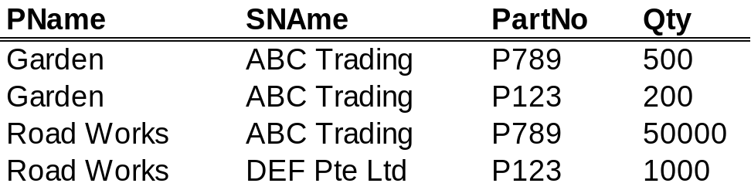
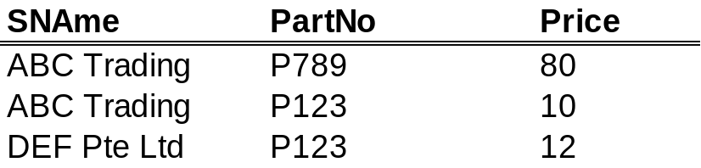
Motivation
Introduction
Projects have suppliers who supply them with a quantity of parts at a certain price.
Each project is identified by a JName.
Each supplier is identified by a SName.
Each part is identified by a PartNo.
Constraint : Supplier must supply a part at the same price regardless of projects.
JName, SName,PartNo → Qty
SName,PartNo → Price

Slide 6
Motivation
Introduction
Use XML to model the Project-Supplier-Part database
Additional requirements:
  Preserve natural inherent hierarchical structure.
  Order of nesting : Project, Supplier, Part
Possible solutions...

Slide 7
Solution 1
Introduction
JSP
Project
Project
Supplier
Supplier
@JName
@SName
@SName
@JName
‘Garden’
‘ABC
Trading’
Part
Part
‘DEF
Pte Ltd’
Part
S
‘Road Works’
S
S
@Sid
@Sid
@Sid
@PartNo
Price
@PartNo
Price
@PartNo
Price
P
P
P
P
@Pid
‘P789’
‘80’
‘P123’
‘10’
‘P123’
‘12’
Qty
@Pid
Qty
@Pid
Qty
@Pid
Qty
‘500’
‘200’
‘50000’
‘1000’
@ denotes attributes
@Sid is a reference to a Supplier element.
@Pid is a reference to a Part Element.
Normalized. No (little) redundancy.
Extensive use of references, pointing relationships.
Model not natural. Difficult to understand.
Less efficient from query processing point of view.

Slide 8
Solution 2
Introduction
JSP
Supplier
Supplier
@SName
@SName
‘ABC Trading’
Part
Part
Part
‘DEF Pte Ltd’
@PartNo
Price
@PartNo
Price
@PartNo
Price
‘P123’
‘12’
Project
‘P123’
‘10’
Project
‘P789’
‘80’
Project
Project
Qty
@JName
@JName
Qty
@JName
Qty
@JName
Qty
‘Road
Works’
‘1000’
‘Garden’
‘200’
‘Garden’
‘500’
‘Road
Works’
‘50000’
A good solution with clear semantics.
But requires re-ordering of elements (i.e. from Project,Supplier,Part to Supplier,Part,Project . But this is not what the user wants.

Slide 9
Solution 3
Introduction
JSP
Project
Project
@JName
@JName
‘Garden’
Supplier
‘Road Works’
Supplier
Supplier
@SName
@SName
@SName
‘ABC Trading’
Part
Part
‘ABC Trading’
Part
‘DEF Pte Ltd’
Part
@PartNo
Qty
@PartNo
Qty
@PartNo
Price
Qty
@PartNo
Price
Qty
Price
Price
‘P789’
‘80’
‘500’
‘P123’
‘10’
‘200’
‘P789’
‘10’
‘50000’
‘P123’
‘12’
‘1000’
Ordering (Project, Supplier, Part) is maintained.
De-normalized. Controlled redundancy.
Containment (Parent-Child) relationships.
Natural model. Easy to understand.
More efficient from processing point of view (compared to Sol 1).
Data redundancy. Possible data inconsistency.
How do we know that Sname,PartNo → Price ?
BUT

Slide 10
FD_{XML}

Slide 11
Functional Dependency in Relational Databases
FD_{XML}
Let r be a relation on scheme R.
X and Y subsets of attributes in R.
Relation r satisfies the FD X → Y if for every X-Value x, ∏_{Y}(σ_{X=x}(r)) has at most one tuple.
E.g. SName, PartNo → Price
This definition is defined for flat tables. How can we extend it for the hierarchical structure of XML databases?

Slide 12
Functional Dependency for XML
FD_{XML}
An XML functional dependency, FD_{XML}:
(Q, [ P_{xi} , ... , P_{xn} → P_{y} ])
where
  Q is the FD_{XML} header path, a fully qualified path expression (i.e. the expression starts from the root)
  Each P_{xi} is a LHS entity type ( which consists of an element name in the XML document, and the optional key attibute(s) ).
  P_{y} is a RHS entity type ( which consists of an element name in the XML document, and an optional attribute name ).
  For any 2 instance subtrees identified by Q, if all LHS entities agree on their values, they must also agree on the value of the RHS entity, if it exists.

Slide 13
Example FD_{XML}
FD_{XML}
JSP
Project
Project
@JName
@JName
‘Garden’
Supplier
‘Road Works’
Supplier
Supplier
@SName
@SName
@SName
‘ABC Trading’
Part
Part
‘ABC Trading’
Part
‘DEF Pte Ltd’
Part
@PartNo
Qty
@PartNo
@PartNo
Price
Qty
@PartNo
Price
Qty
Price
Price
Qty
‘P789’
‘80’
‘500’
‘P123’
‘10’
‘200’
‘P789’
‘10’
‘50000’
‘P123’
‘12’
‘1000’
( /JSP/Project , [ Supplier ,
Part
→ Price ] )

Slide 14
Different Notations for FD_{XML}
FD_{XML}
( /JSP/Project , [ Supplier {SName} ,
Part {PartNo}
→ Price ] )
Show identifier
of elements
( /JSP/Project , [ Supplier ,
Part
→ Price ] )
Basic Notation
( [ Supplier ,
Part
→ Price ] )
Header path
is implied

Slide 15
Distributing FD_{XML}
FD_{XML}
Can make use of existing XML tools if FD_{XML} is expressed in XML too.
Need a DTD to facilitate distribution of FD_{XML}s
<!ELEMENT Constraints (Fd*)>
<!ELEMENT Fd (HeaderPath,LHS+,RHS)>
<!ATTLIST Fd Fid ID #REQUIRED>
<!ELEMENT LHS (ElementName,Attribute*)>
<!ELEMENT RHS (ElementName,Attribute*)>
<!ELEMENT HeaderPath (#PCDATA)>
<!ELEMENT ElementName (#PCDATA)>
<!ELEMENT Attribute (#PCDATA)>
Can be easily translated to its XML Schema equivalent.

Slide 16
Distributing FD_{XML}
FD_{XML}
DTD for the running Project-Supplier-Part database.
<!ELEMENT JSP (Project)*>
<!ELEMENT Project (Supplier*)>
<!ELEMENT Supplier (Part*)>
<!ELEMENT Part (Price?,Quantity?)>
<!ATTLIST Project JName IDREF REQUIRED>
<!ATTLIST Supplier SName IDREF #REQUIRED>
<!ATTLIST Part PartNo IDREF #REQUIRED>
<!ELEMENT Price (#PCDATA)>
<!ELEMENT Quantity (#PCDATA)>

Slide 17
Distributing FD_{XML}
FD_{XML}
FD_{XML} for the Project-Supplier-Part XML database.
Conceptual Notation
FD_{XML} Instance
( /JSP/Project , [ Supplier ,
Part
→Price ] )
<Constraints>
<Fd Fid="SP_Price_FD">
<HeaderPath>/JSP/Project</HeaderPath>
<LHS>
<ElementName>Supplier</ElementName>
<Attribute>SName</Attribute>
</LHS>
<LHS>
<ElementName>Part</ElementName>
<Attribute>PartNo</Attribute>
</LHS>
<RHS>
<ElementName>Price</ElementName>
</RHS>
</Fd>
</Constraints>
DTD for FD_{XML}
<!ELEMENT Constraints (Fd*)>
<!ELEMENT Fd (HeaderPath,LHS+,RHS)>
<!ATTLIST Fd Fid ID #REQUIRED>
<!ELEMENT LHS (ElementName, Attribute*)>
<!ELEMENT RHS (ElementName, Attribute*)>
<!ELEMENT HeaderPath (#PCDATA)>
<!ELEMENT ElementName (#PCDATA)>
<!ELEMENT Attribute (#PCDATA)>

Slide 18
Replication Cost Model for FD_{XML}

Slide 19
Replication Cost Model for FD_{XML}
Replication Cost Model for FD_{XML}
Data replication is sometimes unavoidable (or even desirable!)
  Provided it does not get out of hand.
Measure the degree of replication
  Gauge if it is worth the increased effort for checking consistency, and the increased risk of data inconsistency.
We need a replication cost model.

Slide 20
Definitions
Replication Cost Model for FD_{XML}
Full FD_{XML}
A full FD_{XML} is one which the LHS entity types are minimal, that is, no redundant LHS entity types.
Lineage
  A set of nodes, L, in a tree is a lineage if:
  There is a node N in L such that all the nodes in the set are ancestors of N, and
  For every node M in L, if L contains an ancestor of M, it also contains the parent of M.
* Informal definition : “a straight and unbroken line of elements"

Slide 21
Definitions
Replication Cost Model for FD_{XML}
Well-structured FD_{XML}
Consider the DTD :
        <!ELEMENT H₁ (H₂ *)>
        …
        <!ELEMENT H_{m} (P₁*)>
        …
        <!ELEMENT P_{k} (P_{k+1}*)>
  The FD_{XML}, F =(Q,[P₁, … ,P_{k} → P_{k+1}]), where Q = /H₁/…/H_{m}, holds on
  this DTD. F is well-structured if :
  there is a single RHS entity type (i.e. P_{k+1}).
  the ordered XML elements in Q (i.e. H₁,…,H_{m}), LHS entity types (i.e. P₁,…,P_{k}) and RHS entity type (i.e. P_{k+1}), in that order, form a lineage.
  The LHS entity types are minimal (i.e. no redundant LHS entity types).

Slide 22


Definitions (last one!)
Replication Cost Model for FD_{XML}
Context Cardinality
The context cardinality of XML element X to XML element Y is the number of
times Y can participate in a relationship with X in the context of X’s entire
ancestry in the XML document. Denoted as:
where D is the schema on which this context cardinality is defined, and Q is the header path of X.
JSP
(Document root)
In ERD
1:M
Traditional
Cardinality
Project
Supplier
Part
(Participation Constraint)
X
Supplier
Supplier
Project
1:N
Context
Cardinality
Y
“The number of parts a supplier can supply to a project ”
Part
Part

Slide 23
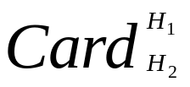
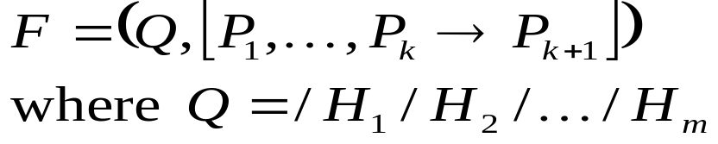
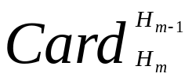
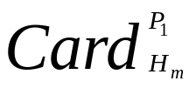
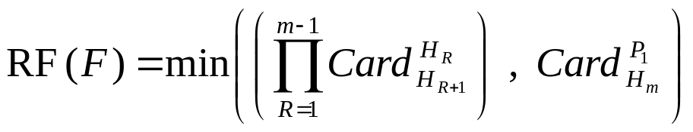
Replication Cost Model
Replication Cost Model for FD_{XML}
H₁
Suppose we have the following well-structured FD_{XML} and it holds on DTD D.
H₂
H_{m-1}
H_{m}
The model for the replication factor is
P₁
P_{k}
P_{k+1}

Slide 24

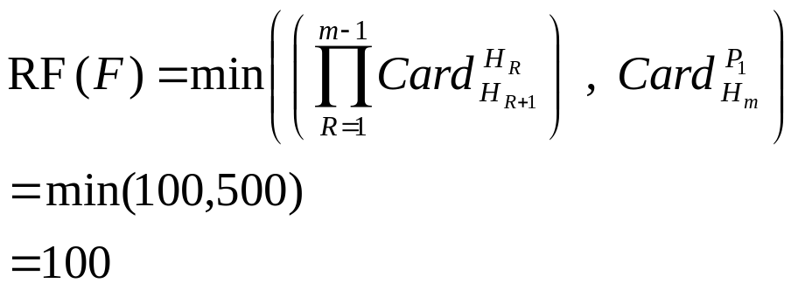

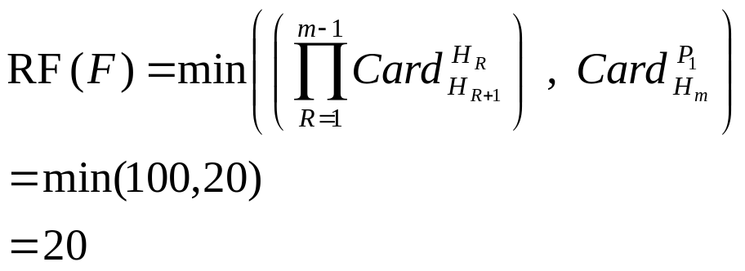
Using the Cost Model
Replication Cost Model for FD_{XML}
F = ( /JSP/Project, [Supplier, Part → Price])
JSP
(Max. no. of Projects under /JSP)
Project
20
(Max. no. of projects a supplier can supply to, in the context of /JSP)
Supplier
What if each supplier is now constrained
to supply to at most 20 projects?
Part
Price

Slide 25
Design insights from Cost Model
Replication Cost Model for FD_{XML}
Length of FD_{XML} header path, Q, should be as short as possible.
Minimize value of 2nd parameter of RF(F).
  If there are several acceptable designs, choose the one with the smallest value for the 2nd parameter of RF(F).
Use model to gauge extra storage requirements due to replication.

Slide 26
Verification of FD_{XML}

Slide 27
Scenario
Verification of FD_{XML}
FD_{XML} Specifications
Distribution
XML Database
XML Database
Verification Process
FD_{XML} Specifications
Verification Results

Slide 28
Verification Process
Verification of FD_{XML}
FD_{XML} Specifications
State
Variables
Context
information
XML Parser
XML Database
Only a single pass through the database is required.
Hash structure (with LHS
values as hash keys)
Set-up using information from FD_{XML}

Slide 29

Running the verification process
Verification of FD_{XML}

Slide 30
Performance
Studies

Slide 31
Dataset
Performance Studies
DBLP – a widely-used, large XML bibliographical database.
80,000 journal records
Check dependency Journal,Volume →Year
<article key="journals/is/HofstedeV97">
<author>A. H. M. ter Hofstede</author>
<author>T. F. Verhoef</author>
<title>On the Feasibility of Situational Method Engineering.</title>
<pages>401-422</pages>
<year>1997</year>
<volume>22</volume>
<journal>IS</journal>
<number>6/7</number>
<url>db/journals/is/is22.html#HofstedeV97</url>
</article>
A sample DBLP
journal record

Slide 32
DOM vs. SAX
Performance Studies
Document Object Model (DOM)
  Builds in-memory tree of nodes.
Simple API for XML (SAX)
  Event-driven parsing
DOM requires too much memory for large datasets.
By maintaining simple context information, we do not need the whole database to be in memory.
SAX parsing is more suitable for our verification technique.

Slide 33
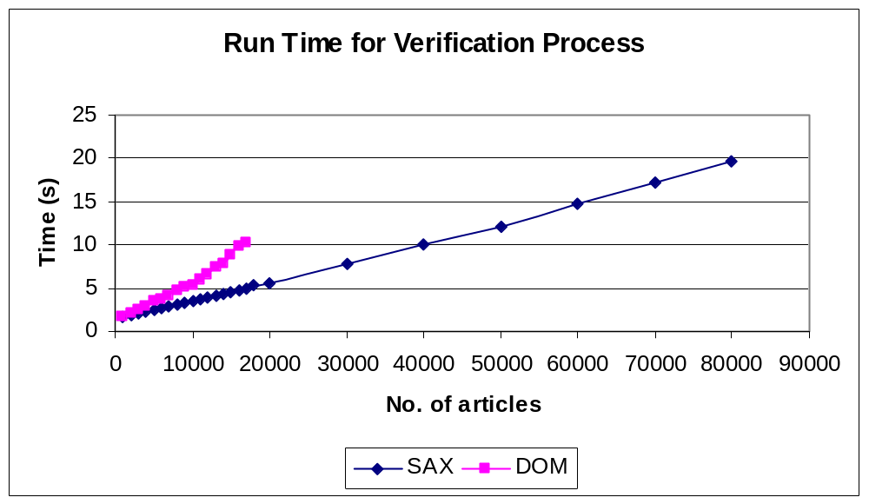
DOM vs. SAX
Performance Studies
Out of memory error
Experiments done on P3 700 MHz machine (128 MB RAM) running WinNT 4.0

Slide 34
Memory requirements
Performance Studies
Hash structure for efficient access.
How much memory does the hash structure (with LHS values as hash keys) take?
Affects the feasibility of incremental checking.

Slide 35
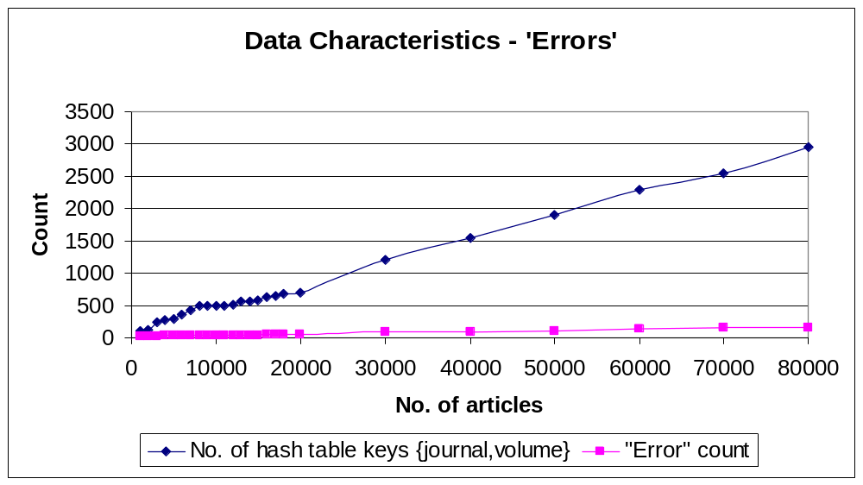
Memory requirements
Performance Studies
2960
No. of entries in the hash table
No. of “errors”
149
Experiments done on P3 700 MHz machine (128 MB RAM) running WinNT 4.0.
A SAX-based parser is used to parse the XML data.
FD_{XML} verification does not take up much memory and scales up well.

Slide 36
Conclusion

Slide 37
Contributions
Conclusion
Representation for FDs in XML databases.
Replication cost model based on FD_{XML}.
FD_{XML} verification.
A framework for FD_{XML} use and deployment.

Slide 38
Future work
Conclusion
Inference rules for FD_{XML} .
Incremental FD_{XML} checking for XML updates.
Integration of FD_{XML} with next generation XML DBMS.
Mining FD_{XML} from XML databases.
MVD_{XML}

Slide 39
Everything in ONE slide
Conclusion
To make XML a data model
FD_{XML}
To distribute/disseminate the known FD constraints
Schema for FD_{XML}
Is redundancy in the XML database controlled?
Replication cost model
To verify FD_{XML} efficiently
A single-pass hash-based technique

Slide 40
References
P. Buneman, S. Davidson, W. Fan, C Hara, WC Tan. Keys for XML. In Proceedings of WWW’10, Hong Kong, China 2001.
TW Ling, CH Goh, ML Lee. Extending classical functional dependencies for physical database design. Information and Software Technology, 9(38):601-608, 1996.
Jennifer Widom. Data Management for XML: Research Directions. IEEE Data Engineering Bulletin, 22(3):44-52, 1999
XY Wu, TW Ling, ML Lee, G Dobbie. Designing Semistructured Databases Using the ORA-SS Model. In Proceedings of the 2nd International Conf on Web Information Systems Engineering (WISE). IEEE Computer Society, 2001.
Michael Ley. DBLP Bibliography.

Slide 41
Q & A

